Slide 1
Exercise 5 Continuous Time-dependent SchrODINGER equation
QUANTUM INFORMATION AND COMPUTING course 2021/2022
Alessandro marcomini (2024286)
Prof. Simone montangero

Slide 2

Exercise goals
Consider the one-dimensional Hamiltonian (translating harmonic oscillator
$H={\frac{\hat{p}}{2}}^{2}+ \frac{1}{2}{(\hat{x}−x_{0}\left(t\right))}^{2}$ $x_{0}\left(t\right)\text{ =} t\text{*}\text{T}\text{, } t \text{∈ [0:}\text{T}\text{]}$
Given $|ψ_{0}$⟩ (the ground state of the Harmonic oscillator), compute$|ψ\left(t\right)$⟩ for different values of T
Plot the square norm of $|ψ\left(t\right)$⟩ as a function of $x$ at different times, and the average position of the particle as a function of $t$

Slide 3

IN THEORY…
Potential shifts linearly in time, causing the wavefunction to translate
Hamiltonian has kinetic component (depending solely on momenta) and potential component (depending solely on coordinante): the time evolution operator can be split symmetricly as follows:
$\exp\left(−i\hat{H}Δt\right)=\exp\left(−i\hat{V}Δt/2\right)$ $\exp\left(−i\hat{T}Δt\right)$ $\exp\left(−i\hat{V}Δt/2\right)$
Therefore, by moving to coordinate/momenta domain the three operators on the left are diagonal: vector-vector multiplication instead of matrix-vector ($O\left(n\right)$ instead of $O\left(n^{2}\right)$). The domain change costs $O(n log n)$ for Fast Fourier Transform.

Slide 4


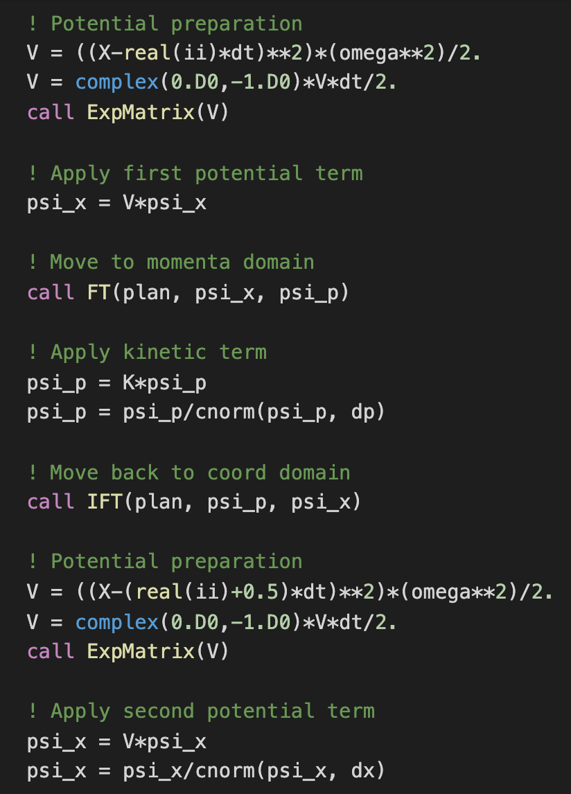

Code developement
Test FFT with Heaviside function
Set discretization parameters: $x ∈\left[−10,10\right], N_{x}=2048, t$ $∈$ [0,T], $N_{t}=2000$
Definition of frequency domain
$$ω∈\left[−{πN_{x}}/{20},{πN_{x}}/{20}\right], N_{ω}=2048$$
Rearranged according to documentation
Exploit FFTW module with self-optimized parameters
Normalize after each step

Slide 5
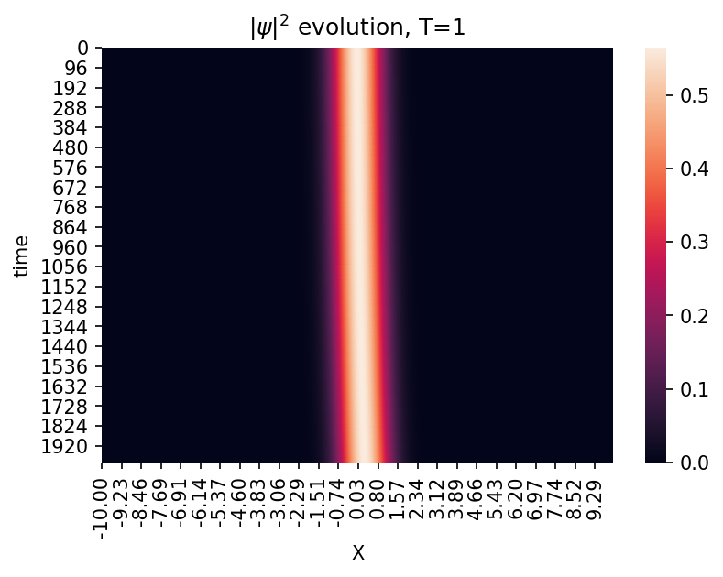
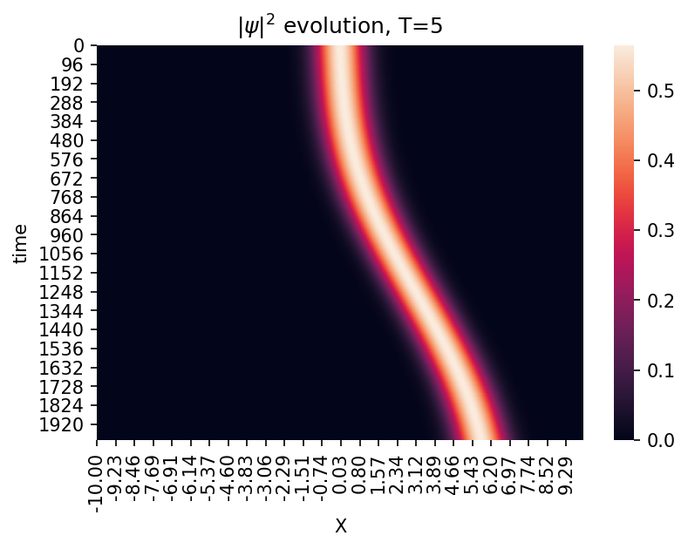
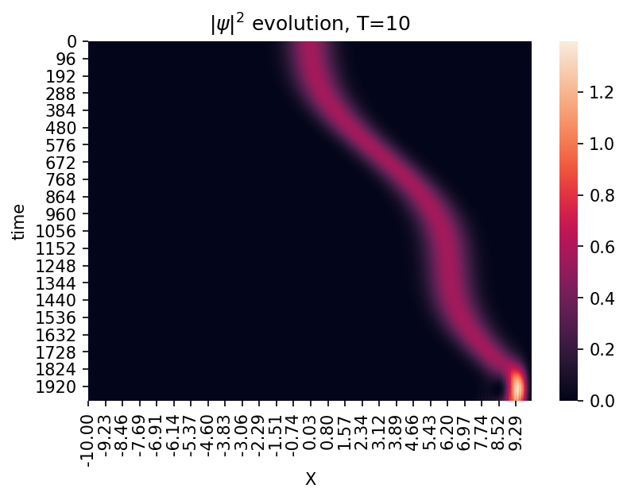
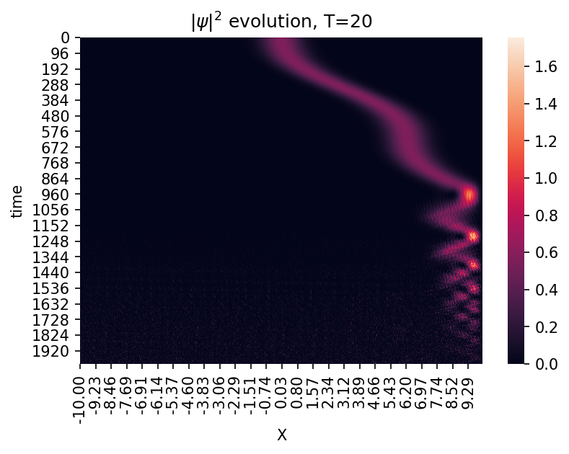

${|ψ|}^{2}$ evolution in time Changing $T$

Slide 6
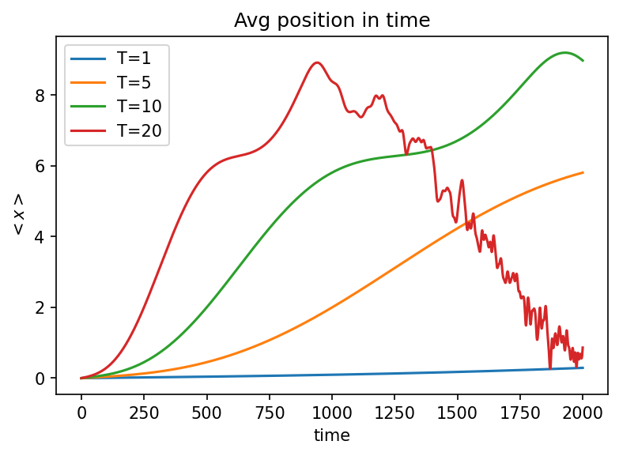

Animated ${|ψ|}^{2}$ evolution and average position

